Slide 1
Comp 608 Algorithms
Week 10 Dr. Tom Schmidt

Slide 2
Week Agenda
Tambayoyi (Quiz in Hausa)
Midterm Comments
Some Pointers on Algorithms?
Graph Algorithms and BFS
DFS
Minimum Spanning Trees
Do Graph Algorithm Hacker Rank Problem?
Wrap-up and review

Slide 3
Tambayoyi 10
1) (You’re gonna need The Google for this one). Come up with a distribution of letter frequency in the English language and use it to build a tree with the 8-least-frequent characters. How many bits do you use to store the least-frequent character?
2) What is better for sorting/ordering a deck of cards? BFS, DFS, or topological sort? Explain your answer.

Slide 4
Wrap-up and review
Answer: comment on the midterm (complaints, suggestions, etc.)

Slide 5
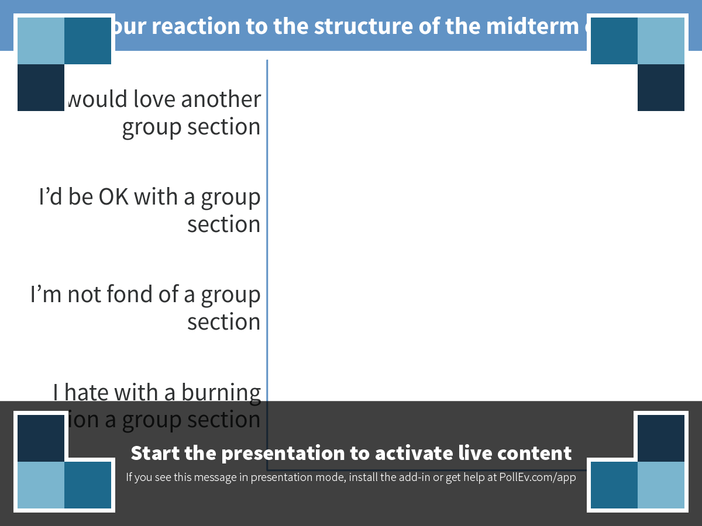
Notes:
What is your reaction to the structure of the midterm on 12/20?
https://www.polleverywhere.com/multiple_choice_polls/QCXWCNBCKTM9gLc

Slide 6
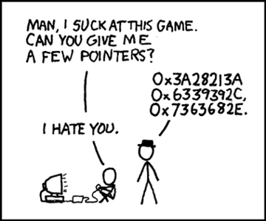
Welcome to the World of Pointers !

Slide 7
Graph Algorithms
Graph Algorithms and BFS

Slide 8
Graph Algorithms
DFS

Slide 9

Notes:
When walking without a map through a town to try to find a store whose address you don't know, should you use BFS, DFS, or Topological Sort. Why?
https://www.polleverywhere.com/free_text_polls/WclPWB9GT5yR6sm

Slide 10
Topological Sort
From Here

Slide 11
Minimum Spanning Trees
From Here

Slide 12
Graph Problems
Some interesting ones from this deck

Slide 13
Google Interview: Brandenburg and Neuschwantstein

Slide 14
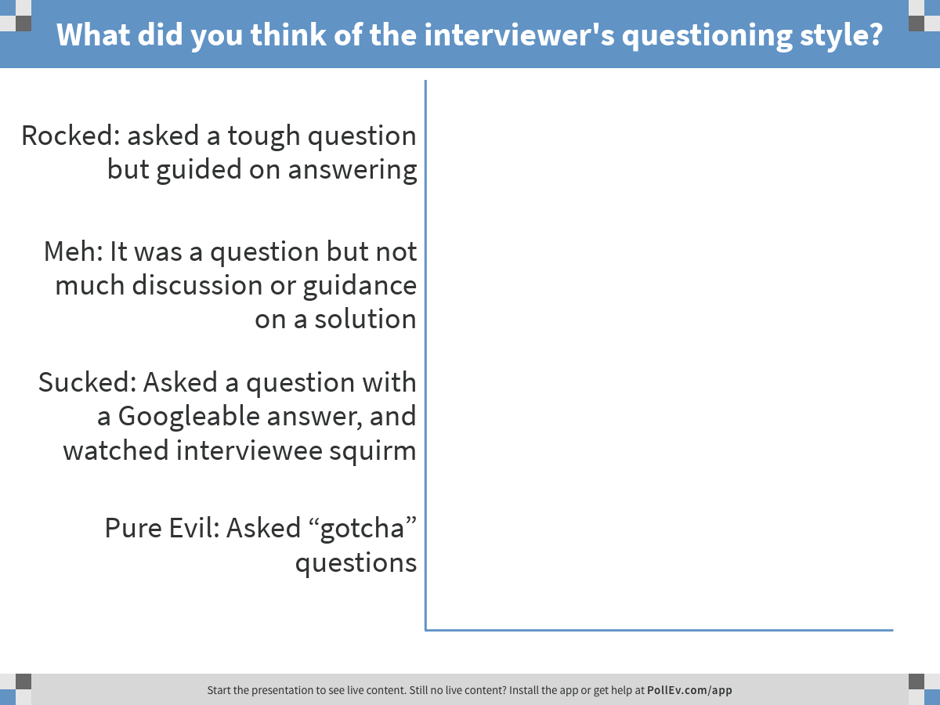
Notes:
What did you think of the interviewer's questioning style?
https://www.polleverywhere.com/multiple_choice_polls/gXPkEw1cpnly2ho

Slide 15
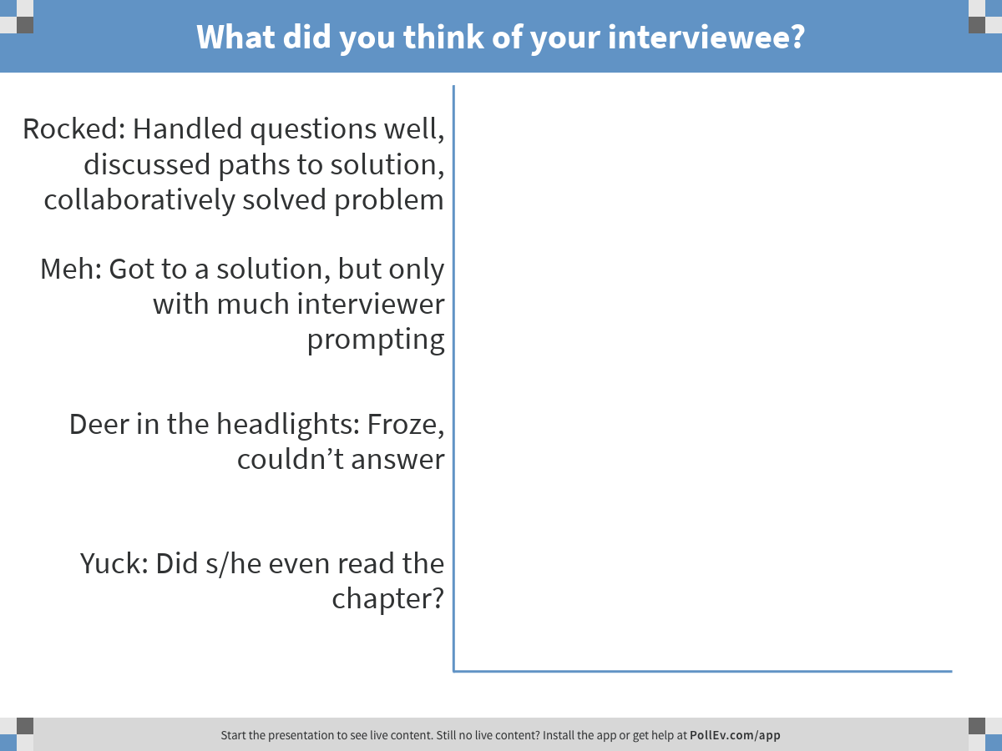
Notes:
What did you think of your interviewee?
https://www.polleverywhere.com/multiple_choice_polls/2Bcwzs8oRbfzQ4C

Slide 16
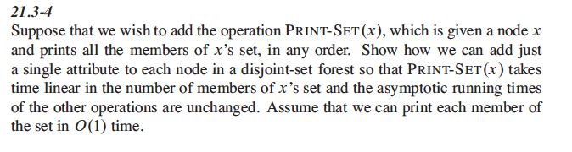
Graph Problems (Team Hamburg)
exercise 21.3-4

Slide 17
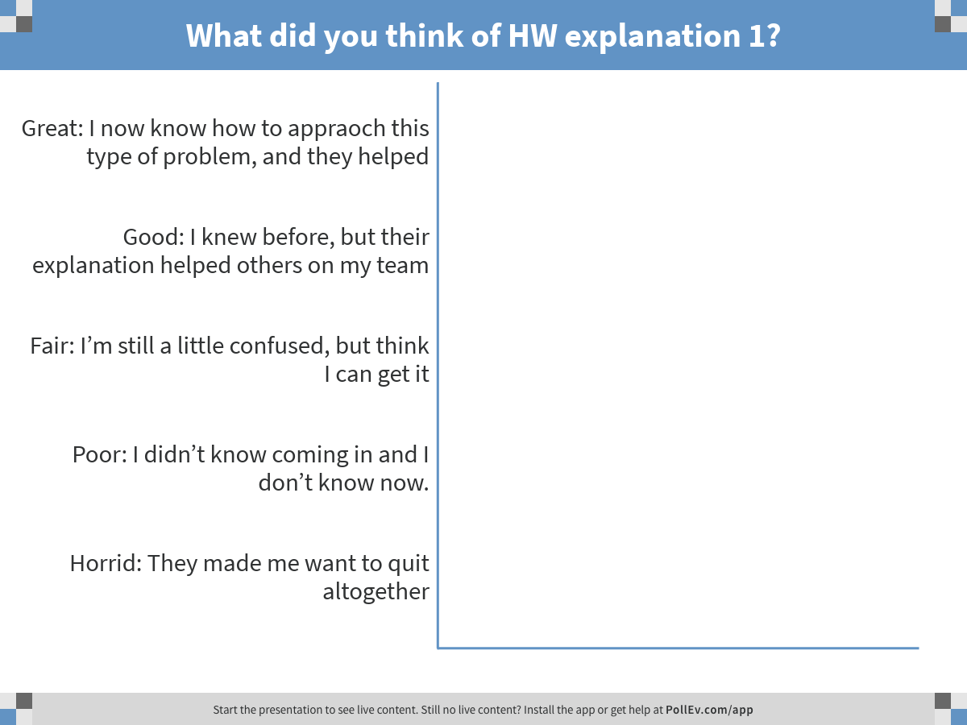
Notes:
What did you think of HW explanation 1?
https://www.polleverywhere.com/multiple_choice_polls/8vmrgZ3VhcBHQvH

Slide 18
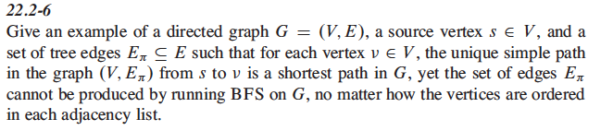
Graph Problems (Team Goethe)
Exercise 22.2-6

Slide 19
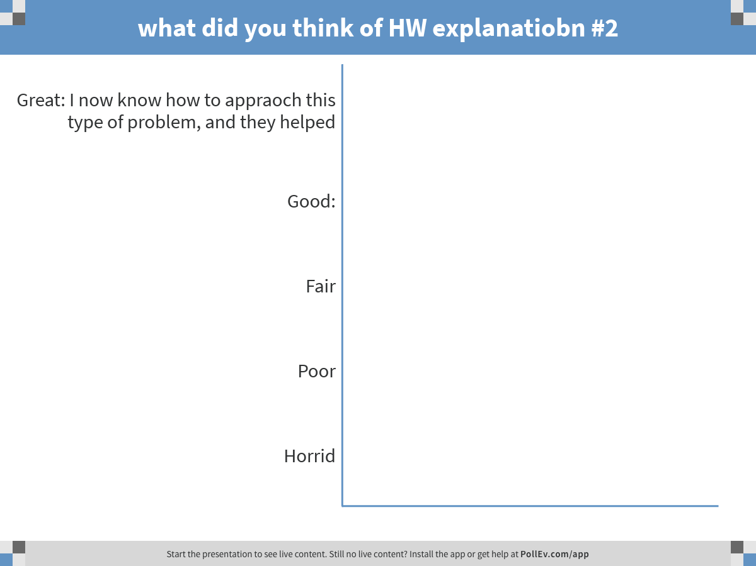
Notes:
what did you think of HW explanatiobn #2
https://www.polleverywhere.com/multiple_choice_polls/BL1zpHfb2mm0Ruz

Slide 20
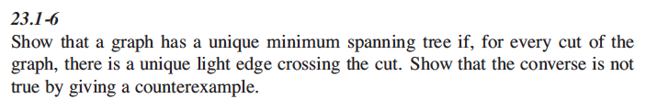
Graph Problems (Team BMW)
Exercise 23.1-6 (Team BMW)

Slide 21
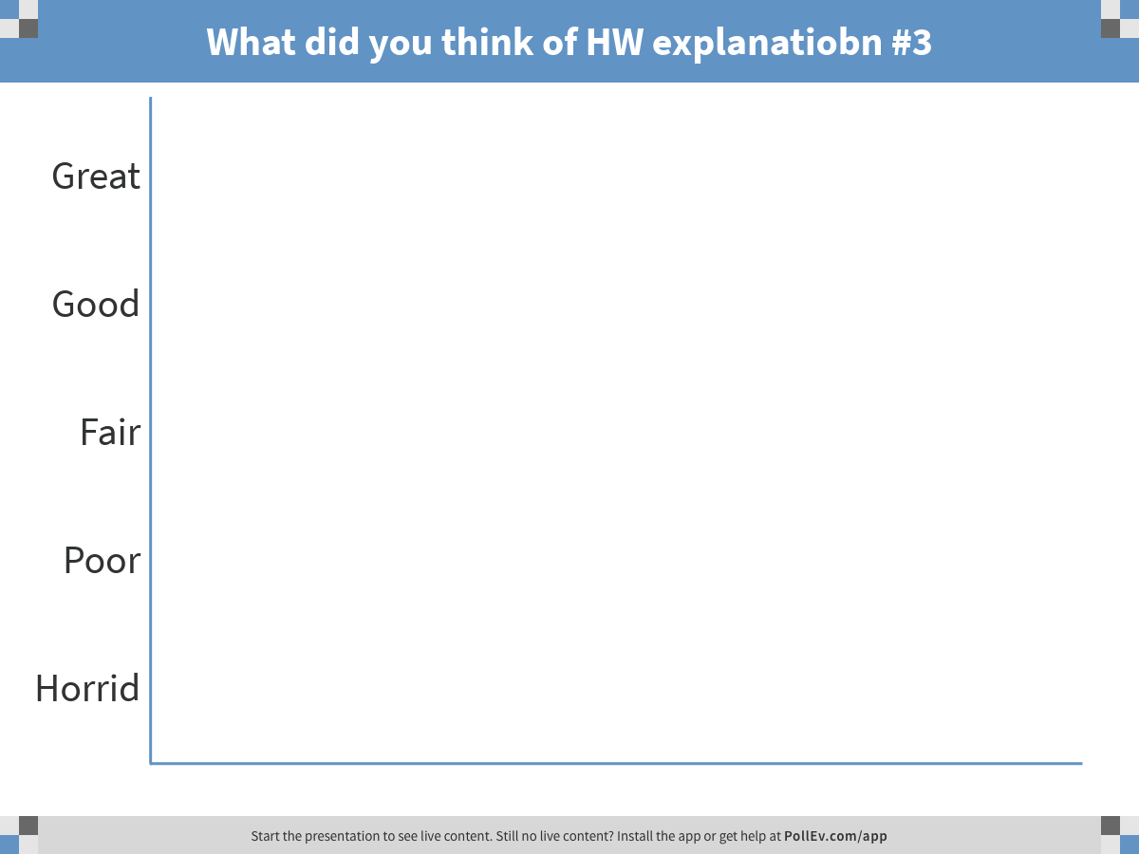
Notes:
What did you think of HW explanatiobn #3
https://www.polleverywhere.com/multiple_choice_polls/Yafw9lfl8l8gPr8

Slide 22
Wrap-up and review
Next week we will have Dijkstra’s Algorithm
Thank you and Shab be Kheyr

